Slide 1
Resource Training Center (2022)
Showcase: The Tech Behind the Tools
Notes:
Hopefully by now, you've heard of the FM Resource Training Center that was established in 2019 to help standardize FM training across the Air Force. During our journey, we discovered that standardizing training is much more difficult than it appears; it's actually the final step in a several-step process. Consider this: how can we standardize training if our processes aren't the same? And how can we standardize processes when we don't have best practices? Come watch and learn how the RTC is adopting new ideas to help align our processes and, ultimately, provide valuable training content to FMers everywhere.

Slide 2
RTC Showcase
Intro: Why Tech & Tools?
Power Platform
Teams
Planner
Forms | Power Automate | List | OneDrive
FICS 2.0
Visual Basic Programming (VBA)
Digital Training Record
Robotic Process Automation & Power Query
DTS Access Bot
FMF Critical Task List
Videos
Get Involved

Slide 3
RTC is Training. Why Tools?
Our mission is to provide standardized on-the-job training for Financial Managers. But how do we standardize training?
Policies & Regulations
Rules
Interpretations
Exceptions
Processes & Procedures
Effective Training
Guides
Tools
Tasks
Workflows
Videos
Slides
Standardization

Slide 4
Training Cycle: Process is Key!
New Training Need
Define Policy Requirement
Match Process to Policy
Standardize Process
Release New Process AND Training
FM cannot change policy since it coincides with the Law.
FM can change process, since it is how we go about abiding by the Law.
When process is standardized, then we can train to that standard process.
Tools!
So how do we standardize Process?

Slide 5
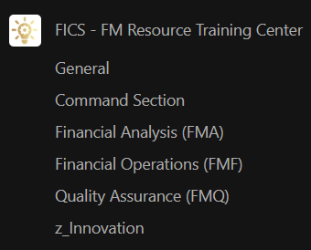
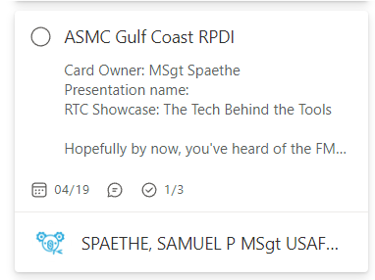
Power Platform
Teams: FICS Team
FICS Team!
Collaborate live with FMers everywhere!
Mass Teams Meetings
Resource Continuity
Planner
Internal task organization

Slide 6
FICS 2.0 Introduction

Slide 7
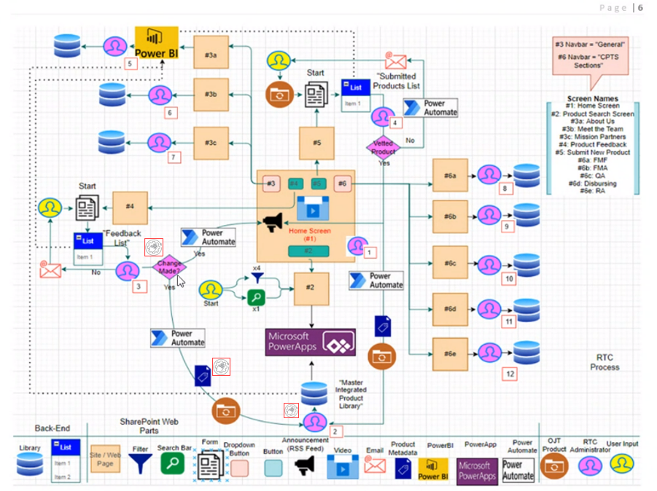
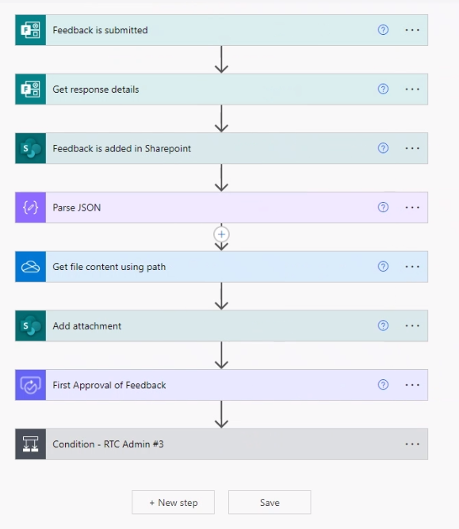
Power Platform: FICS 2.0
Forms | Power Automate | List | One Drive | SharePoint

Slide 8
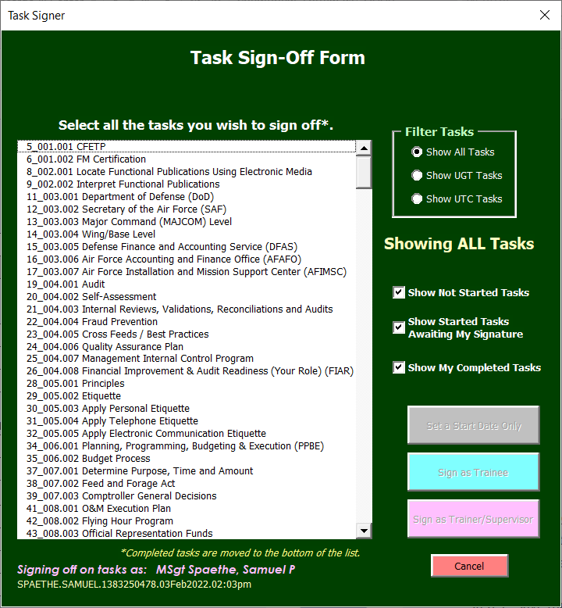
VBA: Digital Training Record
When we learned that TFTR was cancelled, MSgt Lvova reached out to me from Chief Duhart’s office and asked if there was some way to make a viable training record product. Of course we jumped at the idea & opportunity.
The first draft was done in PDF using javascript. Poor TSgt Morris arrived at the RTC right when this project started, so he offered to spend hours adding digital signature spaces to the file… and then we changed it to Excel.
Ultimately, it ended up in Excel. I learned some interesting tricks to use VBA and your login information to produce airtight signatures, and it grew from there into the product you see today!
Notes:
Spaethe – Training Tool

Slide 9
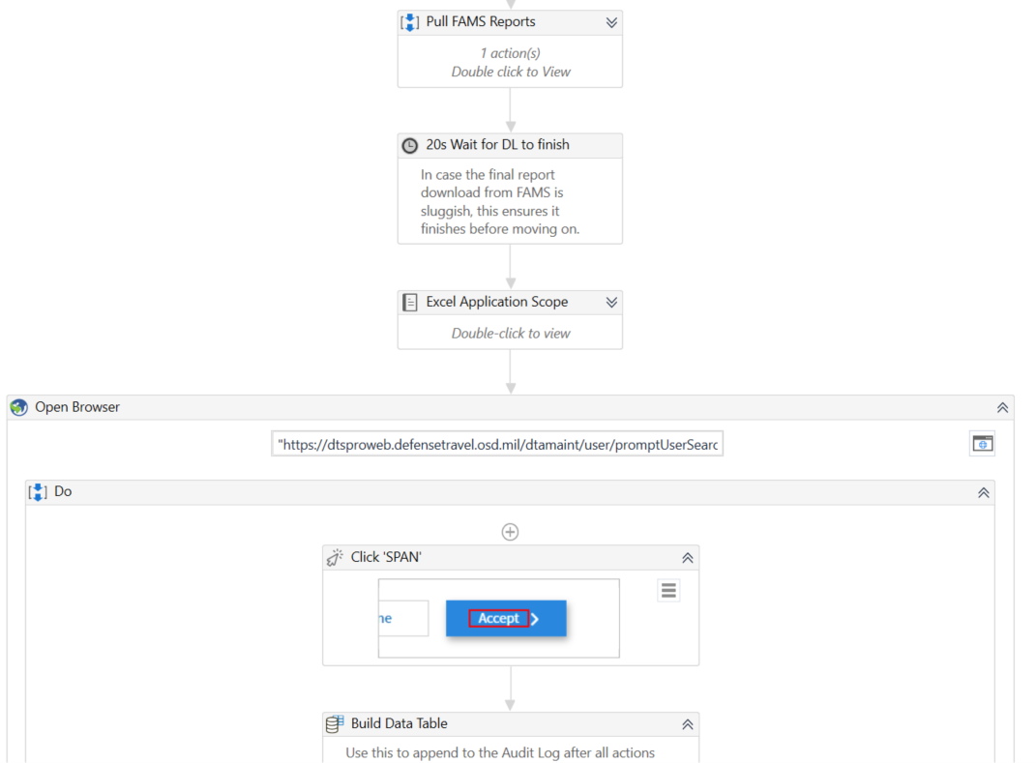
RPA: DTS Access Bot (UiPath)
Air Force level automation
Syncs 4 reports using Power Query
Grants/removes permissions for new appts, terminations, expired training
AO and ODTA roles
DAILY & AUTOMATIC!

Slide 10
RTC Videos Explained
3 Categories of Training Videos
Red: FM Task “How-To”
Purple: Technology “How-To”
Blue: Process / Communication / Change Management
How can the FM career field contribute?
?
?
?
Notes:
Blue has the greatest likelihood of overlapping into the red and purple categories, as it explains how a change in technology or process affects an FM task or day-to-day operations

Slide 11
RTC Videos Explained
“Red” Video
“Purple” Video
“Blue” Video
“A how-to video explaining step-by-step how to accomplish a finance task(s)”
Intended Audience: Airmen doing the FM tasks day-to-day
Step-by-step instructions
“A technology only video explaining how to build or develop a finance tool”
Intended Audience: Technology developer
Step-by-step instructions
Examples:
VBA code (excel)
Power Query (excel)
DAX code / Data Visuals (PowerBI)
Robotic Process Automation (RPA)
Power Apps
“An explanatory & general overview of a process, technologies, and suggested CPTS use cases”
Intended Audience: All FMers
Change management
Marketing
Customer facing potential

Slide 12
Get Involved: FM Talks
FM Talks was introduced as a new platform to provide information and training to the career field.
The first part is to gather the topic source, whether that be PowerPoint slides, a product/tool, and from there generate a script.
Second, we use an animation software, in our case Doodly, to create the scenes of the video.
Third, we record a narration of the script, either within Doodly or using a recording software and importing the audio file into Doodly.
Lastly, we make edits to the video, adding additional scenes or adjusting the timing of animations, until we have the finished product.

Slide 13
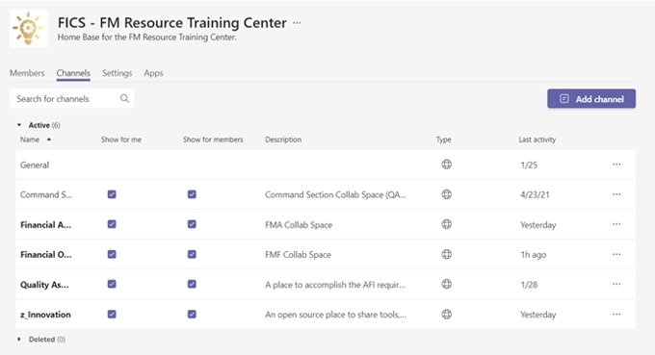
Get Involved: Teams
Use code h57rvmu to join

Slide 14
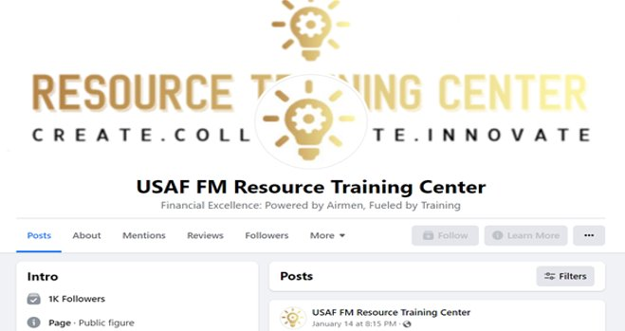
Get Involved: Facebook

Slide 15
Get Involved: FICS!

Slide 16
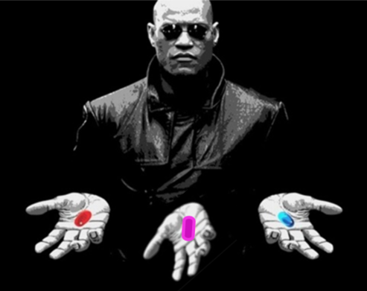
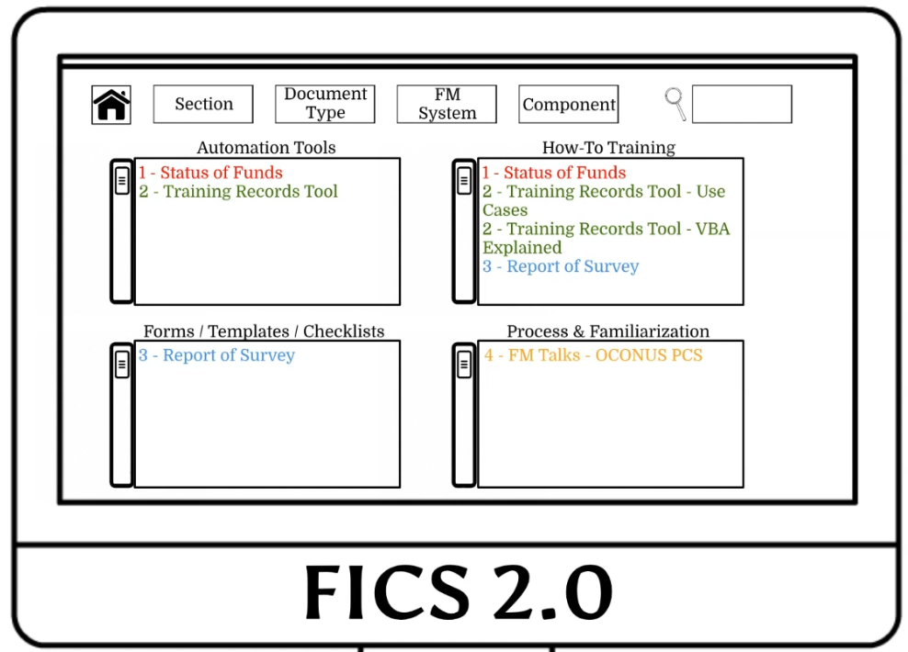
Questions

